Slide 1
Adversarial Search and Game Playing
15.4abcd
14.4abc
13.3ab
Russell and Norvig: Chapter 6

Slide 2
Perfect Two-Player Game
Two players MAX and MIN take turn (with
MAX playing first)
State space
Initial state
Successor function
Terminal test
Score function, that tells whether a terminal
state is a win (for MAX), a loss, or a draw
Perfect knowledge of states, no uncertainty
in successor function

Slide 3
Example: Grundy’s Game
Initial state: a stack of 7 coins
State: a set of stacks
Successor function: Break one stack of coins into two unequal stacks
Terminal state: All stacks contain one or two coins
Score function: terminal state is a win for MAX if it was generated by MAX, and a loss otherwise

Slide 4
Game Graph/Tree
+1
-1
+1

Slide 5
Partial Tree for Tic-Tac-Toe

Slide 6
Uncertainty in Action Model

Slide 7
Uncertainty in Action Model
?
Make the best decision assuming
the worst-case outcome of each action

Slide 8
AND/OR Tree

Slide 9
Labeling of AND/OR Tree

Slide 10
Example: Grundy’s Game
-1
-1
-1
-1
+1
-1
+1
-1
+1
-1
+1
+1
-1
+1

Slide 11
But in general the search tree is
too big to make it possible to reach
the terminal states!

Slide 12
But in general the search tree is
too big to make it possible to reach
the terminal states!
Examples:
Checkers: ~10⁴⁰ nodes
Chess: ~10¹²⁰ nodes

Slide 13
Evaluation Function of a State
e(s) = +∞ if s is a win for MAX
e(s) = -∞ if s is a win for MIN
e(s) = a measure of how “favorable”
is s for MAX
> 0 if s is considered favorable to MAX
< 0 otherwise

Slide 14
Example: Tic-Tac-Toe 17.2a
16.3c
e(s) = number of rows, columns, and diagonals open for MAX
- number of rows, columns, and diagonals open for MIN
8-8 = 0
6-4 = 2
3-3 = 0

Slide 15
Example
Tic-Tac-Toe with
horizon = 2
1
-1
1
-2
6-5=1
5-5=0
6-5=1
5-5=1
4-5=-1
5-4=1
6-4=2
5-6=-1
5-5=0
5-6=-1
6-6=0
4-6=-2

Slide 16
Example
1
1
0
2
1
3
1
2
1
1
1
0
2
0
1
1
0
2
2
3
1
2
2
1
1
0

Slide 17
Minimax procedure
Expand the game tree uniformly from the current state (where it is MAX’s turn to play) to depth h
Compute the evaluation function at every leaf of the tree
Back-up the values from the leaves to the root of the tree as follows:
  A MAX node gets the maximum of the evaluation of its successors
  A MIN node gets the minimum of the evaluation of its successors
Select the move toward the MIN node that has the maximal backed-up value

Slide 18
Minimax procedure
Expand the game tree uniformly from the current state (where it is MAX’s turn to play) to depth h
Compute the evaluation function at every leaf of the tree
Back-up the values from the leaves to the root of the tree as follows:
  A MAX node gets the maximum of the evaluation of its successors
  A MIN node gets the minimum of the evaluation of its successors
Select the move toward the MIN node that has the maximal backed-up value
Horizon of the procedure
Needed to limit the size of
the tree or to return a
decision within allowed time

Slide 19
Game Playing (for MAX)
Repeat until win, lose, or draw
Select move using Minimax procedure
Execute move
Observe MIN’s move

Slide 20
Issues
Choice of the horizon
Size of memory needed
Number of nodes examined

Slide 21
Adaptive horizon
Wait for quiescence
Extend singular nodes /Secondary search
Note that the horizon may not then be the same on every path of the tree

Slide 22
Issues
Choice of the horizon
Size of memory needed
Number of nodes examined

Slide 23
Alpha-Beta Procedure
Generate the game tree to depth h in depth-first manner
Back-up estimates (alpha and beta values) of the evaluation functions whenever possible
Prune branches that cannot lead to changing the final decision

Slide 24
Example

Slide 25
Example
The beta value of a MIN
node is a higher bound on
the final backed-up value.
It can never increase
β = 1
1

Slide 26
Example
The beta value of a MIN
node is a higher bound on
the final backed-up value.
It can never increase
β = 0
1
0
1
0

Slide 27
Example
The beta value of a MIN
node is a higher bound on
the final backed-up value.
It can never increase
β = −1
1
0
1
0
-1

Slide 28
Example
α = −1
The alpha value of a MAX
node is a lower bound on
the final backed-up value.
It can never decrease
β = −1
1
0
1
0
-1

Slide 29
Example
α = −1
β = −1
1
0
1
0
-1

Slide 30
Example
α = −1
β = −1
β = −1
Search can be discontinued below
any MIN node whose beta value is
less than or equal to the alpha value
of one of its MAX ancestors
1
0
1
0
-1
-1

Slide 31
Alpha-Beta Example
0
5
-3
3
3
-3
0
2
-2
3
5
2
5
-5
0
1
5
1
-3
0
-5
5
-3
3
2

Slide 32
Alpha-Beta Example
0
0
5
-3
3
3
-3
0
2
-2
3
5
2
5
-5
0
1
5
1
-3
0
-5
5
-3
3
2

Slide 33
Alpha-Beta Example
0
0
0
5
-3
3
3
-3
0
2
-2
3
5
2
5
-5
0
1
5
1
-3
0
-5
5
-3
3
2

Slide 34
Alpha-Beta Example
0
0
-3
0
5
-3
3
3
-3
0
2
-2
3
5
2
5
-5
0
1
5
1
-3
0
-5
5
-3
3
2

Slide 35
Alpha-Beta Example
0
0
-3
0
5
-3
3
3
-3
0
2
-2
3
5
2
5
-5
0
1
5
1
-3
0
-5
5
-3
3
2

Slide 36
Alpha-Beta Example
0
0
0
-3
0
5
-3
3
3
-3
0
2
-2
3
5
2
5
-5
0
1
5
1
-3
0
-5
5
-3
3
2

Slide 37
Alpha-Beta Example
0
0
3
0
-3
3
0
5
-3
3
3
-3
0
2
-2
3
5
2
5
-5
0
1
5
1
-3
0
-5
5
-3
3
2

Slide 38
Alpha-Beta Example
0
0
3
0
-3
3
0
5
-3
3
3
-3
0
2
-2
3
5
2
5
-5
0
1
5
1
-3
0
-5
5
-3
3
2

Slide 39
Alpha-Beta Example
0
0
0
0
3
0
-3
3
0
5
-3
3
3
-3
0
2
-2
3
5
2
5
-5
0
1
5
1
-3
0
-5
5
-3
3
2

Slide 40
Alpha-Beta Example
0
0
0
0
3
0
-3
3
5
0
5
-3
3
3
-3
0
2
-2
3
5
2
5
-5
0
1
5
1
-3
0
-5
5
-3
3
2

Slide 41
Alpha-Beta Example
0
0
0
0
3
2
0
-3
3
2
0
5
-3
3
3
-3
0
2
-2
3
5
2
5
-5
0
1
5
1
-3
0
-5
5
-3
3
2

Slide 42
Alpha-Beta Example
0
0
0
0
3
2
0
-3
3
2
0
5
-3
3
3
-3
0
2
-2
3
5
2
5
-5
0
1
5
1
-3
0
-5
5
-3
3
2

Slide 43
Alpha-Beta Example
0
0
2
0
2
0
3
2
0
-3
3
2
0
5
-3
3
3
-3
0
2
-2
3
5
2
5
-5
0
1
5
1
-3
0
-5
5
-3
3
2

Slide 44
Alpha-Beta Example
0
0
2
0
2
0
3
2
0
-3
3
2
0
5
-3
3
3
-3
0
2
-2
3
5
2
5
-5
0
1
5
1
-3
0
-5
5
-3
3
2

Slide 45
Alpha-Beta Example
0
0
0
2
0
2
0
3
2
0
-3
3
2
0
5
-3
3
3
-3
0
2
-2
3
5
2
5
-5
0
1
5
1
-3
0
-5
5
-3
3
2

Slide 46
Alpha-Beta Example
0
0
0
2
0
2
0
3
2
0
-3
3
2
5
0
5
-3
3
3
-3
0
2
-2
3
5
2
5
-5
0
1
5
1
-3
0
-5
5
-3
3
2

Slide 47
Alpha-Beta Example
0
0
0
2
0
2
0
3
2
1
0
-3
3
2
1
0
5
-3
3
3
-3
0
2
-2
3
5
2
5
-5
0
1
5
1
-3
0
-5
5
-3
3
2

Slide 48
Alpha-Beta Example
0
0
0
2
0
2
0
3
2
1
0
-3
3
2
1
-3
0
5
-3
3
3
-3
0
2
-2
3
5
2
5
-5
0
1
5
1
-3
0
-5
5
-3
3
2

Slide 49
Alpha-Beta Example
0
0
0
2
0
2
0
3
2
1
0
-3
3
2
1
-3
0
5
-3
3
3
-3
0
2
-2
3
5
2
5
-5
0
1
5
1
-3
0
-5
5
-3
3
2

Slide 50
Alpha-Beta Example
0
0
0
2
1
0
2
1
0
3
2
1
0
-3
3
2
1
-3
0
5
-3
3
3
-3
0
2
-2
3
5
2
5
-5
0
1
5
1
-3
0
-5
5
-3
3
2

Slide 51
Alpha-Beta Example
0
0
0
2
1
0
2
1
0
3
2
1
0
-3
3
2
1
-3
-5
0
5
-3
3
3
-3
0
2
-2
3
5
2
5
-5
0
1
5
1
-3
0
-5
5
-3
3
2

Slide 52
Alpha-Beta Example
0
0
0
2
1
0
2
1
0
3
2
1
0
-3
3
2
1
-3
-5
0
5
-3
3
3
-3
0
2
-2
3
5
2
5
-5
0
1
5
1
-3
0
-5
5
-3
3
2

Slide 53
Alpha-Beta Example
0
0
0
2
1
0
2
1
-5
0
3
2
1
-5
0
-3
3
2
1
-3
-5
0
5
-3
3
3
-3
0
2
-2
3
5
2
5
-5
0
1
5
1
-3
0
-5
5
-3
3
2

Slide 54
Alpha-Beta Example
0
0
0
2
1
0
2
1
-5
0
3
2
1
-5
0
-3
3
2
1
-3
-5
0
5
-3
3
3
-3
0
2
-2
3
5
2
5
-5
0
1
5
1
-3
0
-5
5
-3
3
2

Slide 55
Alpha-Beta Example
1
0
1
0
2
1
0
2
1
-5
0
3
2
1
-5
0
-3
3
2
1
-3
-5
0
5
-3
3
3
-3
0
2
-2
3
5
2
5
-5
0
1
5
1
-3
0
-5
5
-3
3
2

Slide 56
Alpha-Beta Example
1
0
1
0
2
1
2
0
2
1
-5
2
0
3
2
1
-5
2
0
-3
3
2
1
-3
-5
2
0
5
-3
3
3
-3
0
2
-2
3
5
2
5
-5
0
1
5
1
-3
0
-5
5
-3
3
2

Slide 57
Alpha-Beta Example
1
0
1
0
2
1
2
0
2
1
-5
2
0
3
2
1
-5
2
0
-3
3
2
1
-3
-5
2
0
5
-3
3
3
-3
0
2
-2
3
5
2
5
-5
0
1
5
1
-3
0
-5
5
-3
3
2

Slide 58
How Much Do We Gain?
1
Size of tree = O(b^{h})
In the worst case all
nodes must be examined
In the best case, only
O(b^{h/2}) nodes need to
be examined
0
1
0
2
1
2
0
2
1
-5
2
0
3
2
1
-5
2
Exercise: In which order should the
node be examined in order to achieve
the best gain?
0
-3
3
2
1
-3
-5
2
0
5
-3
3
3
-3
0
2
-2
3
5
2
5
-5
0
1
5
1
-3
0
-5
5
-3
3
2

Slide 59
Alpha-Beta Procedure
The alpha of a MAX node is a lower bound on the backed-up value
The beta of a MIN node is a higher bound on the backed-up value
Update the alpha/beta of the parent of a node N when all search below N has been completed or discontinued

Slide 60
Alpha-Beta Procedure
The alpha of a MAX node is a lower bound on the backed-up value
The beta of a MIN node is a higher bound on the backed-up value
Update the alpha/beta of the parent of a node N when all search below N has been completed or discontinued
Discontinue the search below a MAX node N if its alpha is ≥ beta of a MIN ancestor of N
Discontinue the search below a MIN node N if its beta is ≤ alpha of a MAX ancestor of N

Slide 61

Alpha-Beta + …
Iterative deepening
Singular extensions

Slide 62
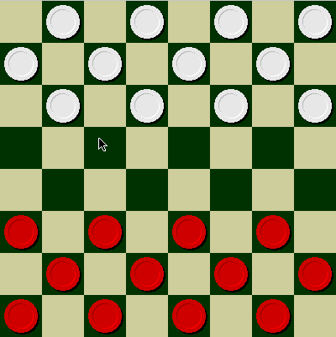
Checkers
© Jonathan Schaeffer

Slide 63
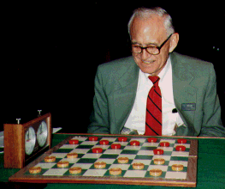
Chinook vs. Tinsley
Name: Marion Tinsley
Profession: Teach
mathematics
Hobby: Checkers
Record: Over 42 years
loses only 3 (!)
games of checkers
© Jonathan Schaeffer

Slide 64
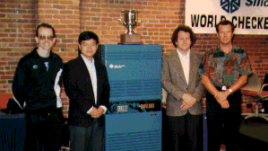
Chinook
First computer to win human world championship!

Slide 65
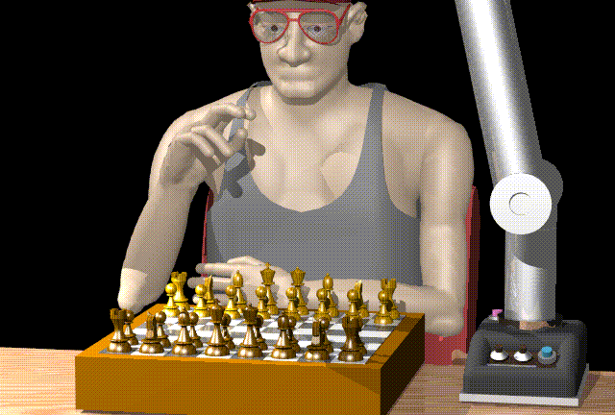
Chess

Slide 66
Man vs. Machine
Kasparov
5’10”
176 lbs
34 years
50 billion neurons
2 pos/sec
Extensive
Electrical/chemical
Enormous
Name
Height
Weight
Age
Computers
Speed
Knowledge
Power Source
Ego
Deep Blue
6’ 5”
2,400 lbs
4 years
512 processors
200,000,000 pos/sec
Primitive
Electrical
None
© Jonathan Schaeffer

Slide 67
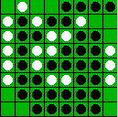
Reversi/Othello
© Jonathan Schaeffer

Slide 68
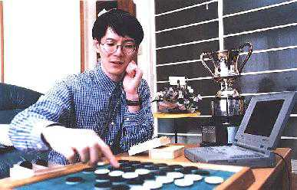
Othello
Name: Takeshi
Murakami
Title: World
Othello Champion
Crime: Man crushed
by machine
© Jonathan Schaeffer

Slide 69
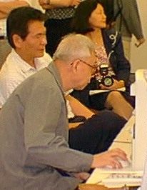
Go: On the One Side
Name: Chen Zhixing
Author: Handtalk (Goemate)
Profession: Retired
Computer skills: self-
taught assembly
language programmer
Accomplishments:
dominated computer go
for 4 years.
© Jonathan Schaeffer

Slide 70
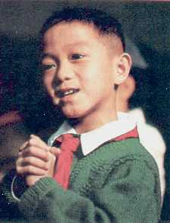
Go: And on the Other
Gave Handtalk a 9 stone
handicap and still easily
beat the program,
thereby winning $15,000
© Jonathan Schaeffer

Slide 71
Perspective on Games: Pro
“Saying Deep Blue doesn’t really think about chess is like saying an airplane doesn't really fly because it doesn't flap its wings”
Drew McDermott
© Jonathan Schaeffer

Slide 72
Perspective on Games: Con
“Chess is the Drosophila of artificial intelligence. However, computer chess has developed much as genetics might have if the geneticists had concentrated their efforts starting in 1910 on breeding racing Drosophila. We would have some science, but mainly we would have very fast fruit flies.”
John McCarthy
© Jonathan Schaeffer

Slide 73
Other Games
Multi-player games, with alliances or
not
Games with randomness in successor
function (e.g., rolling a dice)
Incompletely known states (e.g., card
games)

Slide 74
Summary
Two-players game as a domain where action models are uncertain
Optimal decision in the worst case
Game tree
Evaluation function / backed-up value
Minimax procedure
Alpha-beta procedure

